Slide 1
Week 2

Slide 2
PREVALENCE OF
CLINICAL DEPRESSION
(1994)
LIFETIME 17% (?)
YEARLY 10%
Bipolar 5%
Notes:
PREVALENCE OF

Slide 3
A RECURRING ILLNESS
20% SINGLE EPISODE
80% RECURRENT or CHRONIC

Slide 4
TREATMENT OF DEPRESSION IN
PRIMARY CARE*
Depression: 2nd. Most Common
Disorder in Primary Care
40% Diagnostic Hit Rate
87% Somatic Sx, 13% Mood Sx
(Greist, 2002)

Slide 5
MOST COMMON DISORDERS SEEN IN PRIMARY CARE
Hypertension
Depression
Anxiety Disorders

Slide 6
WORLD HEALTH ORGANIZATION STUDY
Each day in Primary Care Medical Settings:
> 25% of patients have Clinical Depression
> 10% have Anxiety Disorders
> 10% have Substance Abuse Disorders
cont.

Slide 7
Depression: Fluctuating Course
N= 431 ( ¼ : 1st.episode, ½ recurrent, ¼ : double D.)
12 year Follow-up
Symptomatic: 58%, 42%: Sx-free
Time Symptomatic:
> 15% MDD
> 43% Sub-Syndromal ……

Slide 8
Most “Reactive Depressions”
If they reach the intensity level of Major Depression, will show vegetative symptoms.

Slide 9
BIOLOGIC SYMPTOMS
ANHEDONIA
COGNITIVE DYSFUNCTION
SLEEP DISTRUBANCES
APPETITE DISTURBANCES
LOSS OF SEXUAL DRIVE
FATIGUE

Slide 10
Dysthymia
“Ill-Humor”
Persistent Depressive Disorder
5% Of the Population (lifetime prevalence)
Most eventually also develop
Major Depression →

Slide 11
Dysthymia
Pharmacologic Outcome:
33% Excellent Response
33% Good Response
34% Poor Response (Akiskal, 1997)

Slide 12
“The Emperor’s New Drugs”
(Kirsch, et al. 2002)
Meta-Analysis: new antidepressants
FDA trials: 1987-1999
80% of med. Response: duplicated
by placebos
Placebo vs. Meds: 2 point superiority
Meds over Placebo (Hamilton)

Slide 13
But…
Important Issues
Complex co-morbidity
Sequential treatments

Slide 14
Outcomes: Antidepressants:
Treating Severe Depression
Complex co-morbidity
First drug: 30% remission
Second drug: 55% remission
Combinations: 67% remission
No data regarding placebo responses:
relapse prevention.
Long-term outcomes

Slide 15
Problems with the Meta-Analysis
91% of studies were for
6 weeks or less
Animal Studies

Slide 16
Patients Recruited in
Antidepressant Drug Studies
Zimmerman, et al. (2002)
N= 346 (MDD, outpatient practice)
86% would be excluded
from drug studies

Slide 17
ITT: Intent to Treat
Response Rates: MDD
Single Antidepressant trial
Do not tolerate: 15%
No response: 35%
“Responders”: 50%

Slide 18
ITT Rates
“Responder” = 50% ↓ HAM-D, or
HAM-D Score of 7 or less
Responders:
> Full Responders: HAM-D < 7
50%
> Partial Responders:
HAM-D: 9-14: 50%

Slide 19
ITT: The Rest of the Story
“Full Responders”:
> 18% truly asymptomatic
> 82% subtle residual
symptoms
Nierenberg, et al. (1999)

Slide 20
Partial Responders
Time to Next Episode:
* 3 times longer to next episode
remitters vs. partial
responders
Quality of life
(espec. Social Functioning)

Slide 21
Evidence-Based
Medicine and
Treatment
Algorithms

Slide 22
Implications for
Treatment Success
1. Hopelessness and Drop-outs
(long time to response)
2. Compliance: high risk patients
3. Extreme response to side effects
Notes:
Crash on the rocks of inaccurate dx and co-morbidity

Slide 23
First weeks of Treatment
Aim to get some immediate relief:
> Medication strategies
> Exercise
> Bright light
> Combat social withdrawal

Slide 24
Exercise: Antidepressant “Doses”
Equal to antidepressants
Aerobic (in keeping with fitness)
3 times a week: 30 minutes
Two 10 minute periods of exercise
Walk 10,000 steps a day
Must have a coach !

Slide 25
First weeks of Treatment
Aim to get some immediate relief:
> Medication strategies
> Exercise
> Bright Light (all forms of depression)
> Combat social withdrawal

Slide 26
Keys to High-Intensity Light Therapy:
Not just for seasonal depression
10,000 lux
Time: 20 min.+/-
Morning Light best
Cautions: use sunscreen, can provoke mania, if eye diseases
consult ophthalmologist

Slide 27
First weeks of Treatment
Aim to get some immediate relief:
> Medication strategies
> Exercise
> Bright light
> Combat social withdrawal

Slide 28
Rating Scales

Slide 29
On-Line Algorithms
International Psychopharmacology
Algorithm Project:
endorsed by WHO
www.IPAP.org
www.MHC.com
(also P 450: drug interactions)

Slide 30
Choosing a
First-line
Antidepressant

Slide 31


Slide 32
Targeting Neurotransmitters
NE: norepinephrine
5-HT: serotonin
DA: dopamine

Slide 33
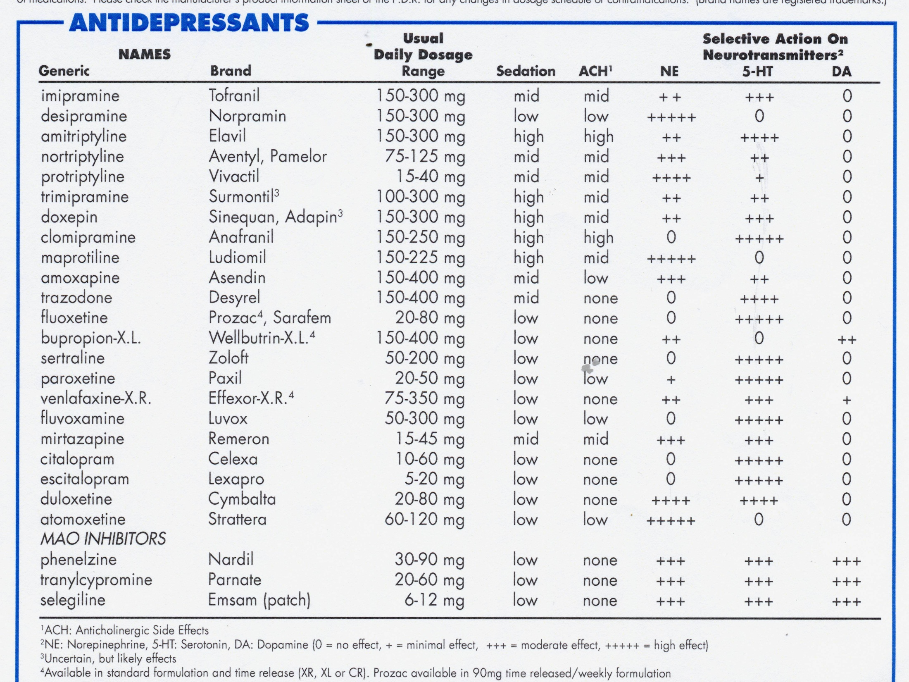

Slide 34
NEWER GENERATION
ANTIDEPRESSANTS
SSRIs: Serotonin (5-HT)
NRIs: Norepinephrine (NE)
Dual Action:
Wellbutrin: NE and Dopamine
SNRIs: 5-HT and NE
Effexor Remeron
Cymbalta Pristiq
Fetzima
Atypical: Brintellix 5-HT, NE DA

Slide 35
Neurotransmitters and Behavior
Serotonin:
Anxiety, Rumination, Irritability,
Aggression, Suicidality
Shelton and Tomarken (2001); Metzner, (2000)

Slide 36
Neurotransmitters and Behavior
Catecholamines:
Dopamine and Norepinephrine:
Anhedonia, Apathy, No Energy
Shelton and Tomarken (2001); Metzner, (2000)

Slide 37
Antidepressants Agorithm
Texas Medication
Algorithm Project
TMAP

Slide 38
ANTIDEPRESSANT ALGORITHM
With Anxiety or Agitation:
SSRIs
Anergic:
Atypical:
PMDD:

Slide 39
Activation vs Switching
Activation: within hours; anxiety
and/or initial insomnia
Switching: 3+ weeks; manic symptoms

Slide 40
Dealing with
Activation

Slide 41
Benzodiazepine Augmentation
Start up
(Cochrane Reports: Furukawa, et al. 2001)
Check for history of substance abuse
Antidepressant and tranquilizers
Early response…fewer drop outs

Slide 42
Addressing Activation in Substance abusing clients
Non-habit forming alternatives:
> Hydroxyzine: Atarax; Vistaril
> Trazodone, Silenar, Remeron
Diphenhydramine: Benadryl
(sleep)

Slide 43
ANTIDEPRESSANT ALGORITHM
With Anxiety or Agitation:
Anergic: Wellbutrin
Atypical
PMDD

Slide 44
Stimulant augmentation with anergic depressions
Ritalin
Adderall
Dexedrine
Provigil

Slide 45
ANTIDEPRESSANT ALGORITHM
With Anxiety or Agitation:
Anergic
Atypical: watch for bipolar
PMDD

Slide 46
ANTIDEPRESSANT ALGORITHM
Pre-Menstrual Dysphoria:
SSRIs

Slide 47
ANTIDEPRESSANT ALGORITHM
Very Severe and/or Recurrent:
Dual Action:
Effexor, Pristiq, Cymbalta,
Remeron, Wellbutrin,
Fetzima (?), Brintellix (?)

Slide 48
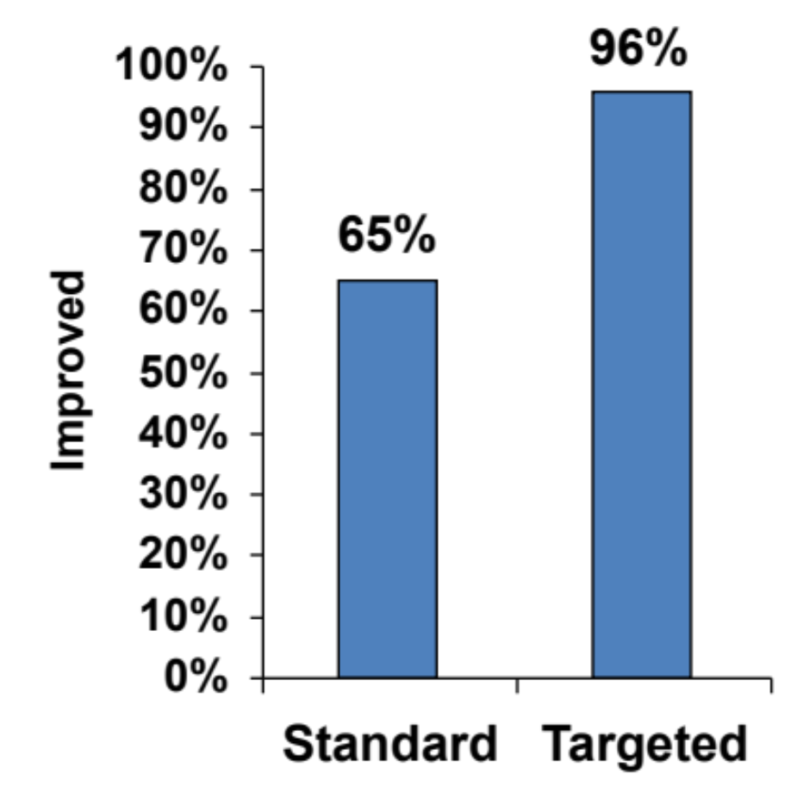
Standard vs. Targeted Treatment
% of Patients Improved
Metzner, 2000
Preliminary study of depressed patients sampled in outpatient private practice settingSTD: Standard Rx
TTD: Targeted : selective antidepressants only
Notes:
Comparing STD and TTD samples using the Clinical Global Improvement Scale, 2 out of 3 STD patients were improved or very improved compared with 9 out of 10 in the TTD group. The effectiveness of STD was comparable to the usual percentages seen in antidepressant clinical trials. The effectiveness of TTD was similar to the proportion of patients who ultimately improve after multiple antidepressant trials, although most of the TTD patients did not require switching to other agents.
REFERENCE
Metzner RJ, The targeted treatment of depression, presented at the symposium Neurotransmitters and Depression: New Possibilities at the annual meeting of the American Psychiatric Association in Chicago, May, 2000

Slide 49
GUIDELINES for
MEDICAL TREATMENT of
DYSTHYMIA
IRRITABILITY: SSRIs
LOW ENERGY, APATHY, LOW-GRADE ANHEDONIA: Wellbutrin
not based on empirical studies

Slide 50
Additional Considerations in Medication Choices
Side Effects
Patient Preferences
Pharmacokinetics

Slide 51
PHASES OF TREATMENT
ACUTE: Until Asymptomatic
CONTINUATION: 6 months @
Same Dose
MAINTENANCE: Third Episode:
Lifetime Treatment

Slide 52
Continuation Phase of Treatment
Minimum of six months…same dose
Patient-initiated discontinuation
High rates of acute relapse
Serotonin and emotional blunting
Dampens dopamine

Slide 53
Antidepressant
Discontinuation Syndromes
Symptoms: nausea, dizziness,
malaise, electric shock-like
sensations
Most likely:
Paxil, Effexor, Cymbalta, Pristiq
Least likely: Prozac

Slide 54
Maintenance Phase
Using antidepressants to
Avoid Recurrence
John Davis (1992); Bipolar Network (2010)
Chronic treatment antidepressants
50-70% of patients benefit

Slide 55
ADEQUATE TRIAL
DOSE
COMPLIANCE
TIME
BLOOD LEVELS

Slide 56
Response
Remission
Partial 25-50%
Poor 0-25%

Slide 57
Overview: Options for
Inadequate Response
Optimization
Augmenting
> Combination Treatments
Switching Drug Classes

Slide 58
Optimization
↑ dose; ↑ time

Slide 59
Augmenting:
Combination

Slide 60
Switching
Classes e.g serotonin → norepinephrine reuptake inhibitor

Slide 61
STAR-D
(2007)
N= 2876 (loss of 1/3)
Ages 18-75
Average patient:
3 medical illnesses
65%: psychiatric co-morbidity

Slide 62
STAR-D
80%: chronic or recurrent
25%: have been depressed
for 2+ years
53%: anxious depressions

Slide 63
STAR-D
(2006)
PHASE ONE:
Celexa: average doses 40 mg
Response rates: 60%
Remission rates: 30%
Average time to remission: 7 weeks
KEY: aggressive dosing

Slide 64
Aggressive Treatment
Phase One
Celexa:
1. Starting dose: 20 mg qd
2. Day 28: 40 mg qd
3. Day 42: 60 mg qd
* As tolerated

Slide 65
STAR-D
(2006)
Time to response: 6 weeks
Time to remission: 7 weeks
50% of remitters: 6-12 weeks
Non-remitters: switch
or augment

Slide 66
Phase One
30% remission

Slide 67
STAR-D
(2006)
PHASE TWO
Non-remitters: randomized:
> Switch (meds or CBT)
> Augmentation

Slide 68
After Phase 2
55% reach remission

Slide 69
STAR*D
Final Outcomes
67%
Complete remission

Slide 70
STAR-D
Cumulative Sustained
Recovery Rate
43%

Slide 71
Dropouts associated with each new step
10-20% per step
Why?
More tx resistance
Demoralization
Final Number: 1214
(2876)

Slide 72
STAR-D: Short Comings
Subtype of depression
not addressed:
e.g. Anxious versus anergic
No screening for thyroid

Slide 73
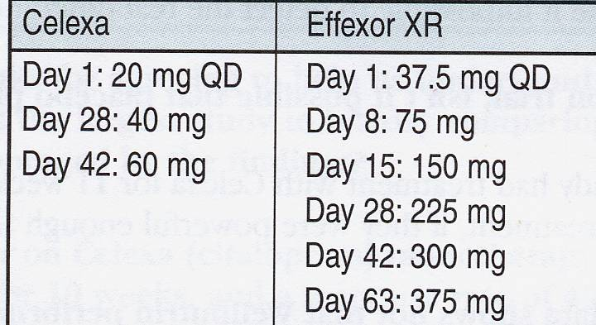
STAR-D Monotherapy

Slide 74
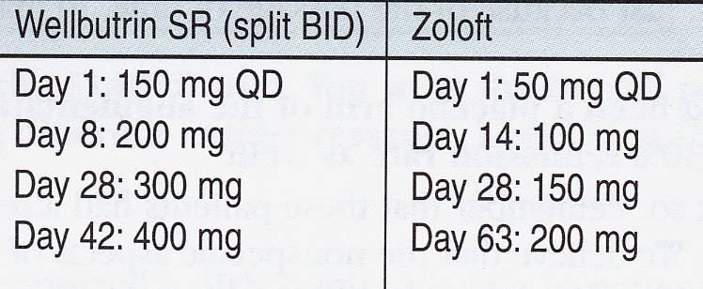
STAR-D Monotherapy

Slide 75
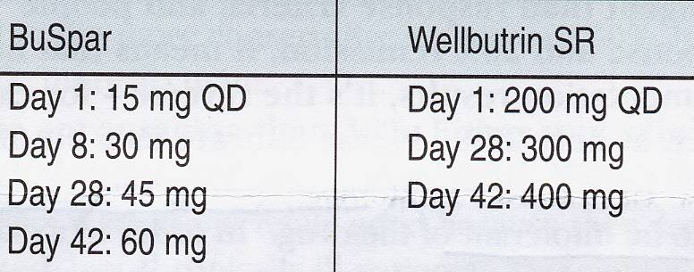
STAR-D Augmentation
Guidelines

Slide 76
What Can Be Learned from
STAR-D
Use of rating scales
Aggressive dosing
Some suggestions: next steps
Testament to the difficulties in
treating very severe depression

Slide 77
TMAP Outcomes
Personalized medical treatment:
identify subtypes
Aggressive, sequential treatment
Measurement-based treatment

Slide 78
STAR-D and TMAP: Conclusions
If little response (0-25%): switch
If partial response (25%+): augment
76% remission
Highest yield augmenters:
> Anxious depression: BuSpar
> Anergic depressions: Wellbutrin
> T3

Slide 79
PARTIAL RESPONSE
STRATEGIES
FIRST: Check Compliance &
Substance Abuse
INCREASE DOSE
AUGMENT

Slide 80
Other augmentation
Strategies

Slide 81
Augmentation Strategies
Lithium: 0.3-0.6 mEq/l
> ↓ relapse x 3
> 7 fold ↓ suicides

Slide 82
THYROID
Adding T3 or T4: augmentation
T4 for rapid cycling
Hypothyroid in Lithium therapy

Slide 83
Hypothalamus
↓
TRH
↓
Pituitary
↓
TSH
↓
Thyroid
T3 ← Gland →T4

Slide 84
TSH
Thyroid Stimulating
Hormone
Elevations can cause depression and/or reduce effectiveness of antidepressants
Sub-clinical Hypothyroid

Slide 85
Depression and
Hypo-Thyroid
The most common medical
cause of depression (10%)
Grade I: ↓ T3 and T4: ↑ TSH
Grade II: Normal T3/T4, but ↑ TSH
(Wolkowitz, 2003; Zweifel, 1997)

Slide 86
“Normal” TSH Levels
High Normal Range 3.0
|
|
Median 1.3
|
|
Low Normal Range 0.3
miliIU/Liter

Slide 87
Slight Elevation: TSH Level
High Normal Range 3.0
|
| 2.2
Median
|
|
Low Normal Range 0.3
miliIU/Liter

Slide 88
Optimal TSH Level: Mood Disodrer
High Normal Range 3.0
|
|
Median
| 1.0
|
Low Normal Range 0.3
miliIU/Liter

Slide 89
Thyroid Augmentation for Sub-clinical Hypothyroid
T4: levo-thyroxine:
> Synthroid, Levothyroid, Levoxyl
> Not as effective as T3
T3: triiodothyronine:
> Cytomel
> 25-75 mcg. qd

Slide 90
Stimulant Augmentation

Slide 91
MAOIs

Slide 92
New MAOI:
Emsam selegiline transdermal:
6-12 mg per day

Slide 93
Augmentation Strategies
Atypical Antipsychotics:
* Zyprexa *Abilify * Seroquel
* Latuda
*Geodon *Risperdal ?

Slide 94
High Intensity Light Therapy
Seasonal and
non-seasonal
Anxiety
Caution with:
Bipolar
Details later

Slide 95
POOR RESPONSE
STRATEGIES
CHECK COMPLIANCE and
SUBSTANCE ABUSE
INCREASE DOSE
SWITCH CLASSES:
e.g. SSRI → NE
NE → SSRI

Slide 96
Within Class Switches
Reasons for switch:
> Tolerability
> Efficacy (espec. with partial Response)
Two SSRI failures: switch classes

Slide 97
SEROTONIN
SIDE EFFECTS
SEXUAL DYSFUNCTION
> Inorgasmia →
APATHY and EMOTIONAL BLUNTING
WEIGHT GAIN (10% after one year)

Slide 98
Prevalence Sexual
Problems / Complaints
Reporting: 14%
Elicited on questionnaire 60%
N: 6300: only 29% had no
other risk factors except
antidepressant exposure……

Slide 99
Prevalence Sexual S.E. without other probable causes
Celexa, Lexapro, Effexor 30%
Zoloft, Paxil 28%
Prozac, Remeron 24%
Wellbutrin 7%
Clayton, et al. 2002

Slide 100
Sexual Solutions
Drug Holidays (not advised)
Timing of drug and sex →
Medications:
* Viagra 50-100 mg

Slide 102
Late-Onset
Serotonin-Related
SIDE EFFECTS
APATHY and
EMOTIONAL BLUNTING
(inability to cry)
“poop out”

Slide 103
Apathy and Emotional Blunting
J. Read, et al. 2014 New Zealand study
1,829 patients
83% reported significant + responses to Ads
Emotionally numb/blunted:
> 24% mild but noticeable
> 36% moderate or severe
“Don’t feel like myself” 52%

Slide 104
LATE EMERGING SEROTONIN
SIDE EFFECTS
SEXUAL DYSFUNCTION
> Inorgasmia
APATHY and EMOTIONAL BLUNTING
WEIGHT GAIN (10% after one year)

Slide 105
GENDER DISTRIBUTION
DEPRESSION
Disorder Female : Male
CHILDREN
TEENS
ADULTS
BI-POLAR I
BI-POLAR II
1 : 1
2 : 1
2 : 1
1 : 1
2 : 1

Slide 106
Premenstrual Dysphoric
Disorder: PMDD
Average female: 400 periods
70 %: PMS at some point in time
30 %: significant PSM
4 %: PMDD

Slide 107
Premenstrual Dysphoric
Disorder: PMDD
Premenstrual exacerbation
of Major Depression symptoms
90% of women who successfully
commit suicide: premenstrual

Slide 108
Premenstrual Dysphoric
Disorder: PMDD
Treatments:
> reduce caffeine, alcohol, salt,
sugar, and stop smoking
> exercise
> Serotonin antidepressants
> St. John’s Wort (case reports)

Slide 109
Premenstrual Dysphoric
Disorder: PMDD
Antidepressant treatments
Must target Serotonin
Intermittent versus
continuous
Quick onset of actions

Slide 110
PMDD and SEROTONIN
Fluctuating estrogen levels can have
an impact on
Tryptophan hydroxylase
(rate-limiting enzyme for production of 5-HT)

Slide 111
Allopregnenolone
Neuro-steroid: synthesized in
the brain
Potent GABA-A agonist
Low levels in MDD CSF
(↑ with successful treatment)

Slide 112
Allopregnenolone
PMDD: marked reduction
Rapid increase with SSRIs
but not with non-
serotonin antidepressants

Slide 113
Premenstrual Dysphoric
Disorder: PMDD
Calcium supplementation
2 double blind, placebo controlled
studies
1200 mg per day (4 Tums)
55% vs 36%

Slide 114
Myths about Pregnancy and “Well Being”
Risks of major depression: prenatal and
postpartum: 21% (highest risk for women)
Risks of discontinuing medications:
Bipolar: 83% acute relapse
Major depression: 68% relapse

Slide 115
Depression and Pregnancy
Depression and pregnancy:
> Hypercortisolemia
> Substance abuse
> Suicide attempts
> Post-partum exacerbation
(bonding and attachment)

Slide 116
Depression and Pregnancy
Depression and pregnancy:
> Hypercortisolemia
> Substance abuse
> Suicide
> Poor self care
> Post-partum exacerbation
(bonding and attachment)

Slide 117
FDA RATINGS:
USE DURING PREGNANCY
A: No Risk. Well controlled studies
B: No Evidence of Risk
C: Risk Cannot Be Ruled Out
D: Positive Evidence of Risk
X: Contraindicated in Pregnancy

Slide 118
Newer Antidepressants and Pregnancy
FDA classifications: all “C” except:
Paxil: D
> Discontinuation syndrome
> 2nd and 3rd trimester exposure:
risk of cardiac defects
(2% vs 1%)

Slide 119
Antidepressants: Meta-analysis
(Einarson and Erinarson, 2005)
N: 1774 exposed fetuses
First trimester exposure
Major malformations: 2-3%
This equals the base rate in
un-exposed fetuses

Slide 120
Antidepressants: Risks
(Hauser, et al., JAMA 2009)
Small but statistically non-significant
increase in miscarriages
Not compared to
non-depressed subjects
Premature birth: 20% greater: in
both medicated and non-med
mothers

Slide 121
Antidepressants: Risks
No specific birth defects
??? Cardiac defects in SSRIs ???
maybe first trimester

Slide 122
Zoloft
Lowest
Level
2%
Average antidepressant levels
7% of the mothers blood level
Notes:
122

Slide 123
PSYCHOTIC DEPRESSIONS
Antidepressants (AD) 35%
Antipsychotics (AP) 45%
AD + AP 75%
ECT 90%
Note: Continuation Phase: One Year
AD and AP

Slide 124
ECT: Electro-convulsive
Therapy
Shock Treatments
V

Slide 125
DEPRESSION IN CHILDREN and ADOLESCENTS
MAJOR
DEPRESSION
Children 3%
Teens: 10%
35% recurrent
50% bipolar

Slide 126
Depression in Young Children
Luby, et al. (2002)
N=49
Using DSM-IV criteria: 12 Dx as MDD
Thus must use modified criteria…
DSM 5: not much help

Slide 127
MDD Children: Modified Diagnostic Criteria
Most of the day, more days than not
Play: themes of death, suicide, self-
destruction (61%)
Depressed or irritable mood or
Diminished interest plus 4 Sx
(vs. 5 for adults)

Slide 128
SYMPTOMS IN
CHILDREN
ANHEDONIA / WITHDRAWAL (60%)
IRRITABILITY (81%)
LOW SELF-ESTEEM (78%)
SCHOOL FAILURE
LONLINESS
VEGETATIVE Sx: Sleep and
Appetite Disturbance (80%)
LOW ENERGY (58%) …..

Slide 129
Child and Adolescent Depression:Additional Signs
Vague, non-specific physical complaints
Running away from home
Being bored
Extreme sensitivity to rejection or failure
Reckless behavior; Acting Out
Difficulty with relationships
Substance Use / Abuse

Slide 130
Problems with the studies
Meta analysis:
Effect Size: 0.25

Slide 131

T A D S
Treatment for Adolescents with Depression Study
Effectiveness Outcomes
(2004)

Slide 132
Random Assignment
NIMH Study
N: 432
Placebo
Prozac
Cognitive Behavioral Therapy
Combo: drug and CBT

Slide 133
Time to Onset of Effects
Anxiety: 1-2 weeks
Depression: 4-6 weeks
but responders in 10-12
week range !

Slide 134
Paxil and Increased Suicidality
UK study…N=1300 adolescents
Increased suicidality:
Placebo: 1.2%
Paxil: 3.4%
No actual Suicides
33 suicidal incidents …..

Slide 135
Classification of
Suicidal “Events”
(Posner, et al., 2007)
Completed suicides
Suicide attempts
Preparation for suicide attempt
Threats of suicide/gestures
Suicidal ideations (70%)
Self-injurious behaviors
without suicide intent
Notes:
135

Slide 136
Impact of Antidepressants on Suicide Rates
1957-1985: USA: all ages
suicide rates ↑ 31%
1986-1999: 4-fold ↑ prescriptions
for antidepressants
1986-1999: USA: all ages
suicide rates ↓ 13.5%
Grunebaum, et al. (2004)

Slide 137
Impact on Prescribing
CDC: Lubell, et al. 2007
1950-1990: 300% ↑ suicides (ages 10-24)
1990-2003: suicides ↓ 29% (ages: 10-24)
30-40% decrease in prescriptions for
antidepressants for kids and teens

Slide 138
FDA Review
24 studies N= 4400
Placebo: 2% ↑ SI
Drugs: 4% ↑ SI
No actual suicides

Slide 139
Impact Since 2003
Decrease in prescriptions (30-40%)
Increased suicidal
ideations/attempts
No significant increase in actual suicides

Slide 140
Antidepressants Protective
Against Suicide
Gibbons, et al. (2012) Archives of General Psychiatry
All articles on: Effexor & Prozac
(fluoxetine; venlafaxine)
Protect against suicide (adults) and
no evidence of increased
suicidality in children and teens

Slide 141
Where might Increased
Suicidality be an issue ?

Slide 142
Lack of Quality Control
BMC Medicine (2013)
44 Products…dozens of companies
50% contained plant species not listed
on the bottle
30% had none of the plant listed on the
bottle
One St. John’s Wort product: no SJW…
instead: an herbal laxative

Slide 143
Products Endorsed By:
USP
(US Pharmacopia)

Slide 144
Over-the-Counter
Cautions:
Natural does not
necessarily mean safe

Slide 145
Research and
Marketing Bias

Slide 146
Cochrane Data Base:
Systematic Studies
Meta analysis
St. John’s Wort; equal efficacy to
prescription antidepressants
Linde, et al. (2008); Cochrane data-
base (2011)

Slide 147
ST. JOHN’S WORT
TREATMENT
Reasons for use
900-1800 mg per day
Three, divided doses
Cost: $1.00 per day

Slide 148
ST. JOHN’S WORT
Side effects: mild GI, sedation.
No: weight gain
or sexual dysfunction
Watch for Drug-Drug
Interactions!

Slide 149
SAM-e
Meta-analysis
(Williams, et al. 2005)
Comparable efficacy to
Antidepressants
Much better tolerated

Slide 150
SAM-e
Treatment: Major Depression
400-1600 mg per day
$3-5 per day
IV Dosing

Slide 151
SAM-e
So Far lack of significant drug-drug interactions
Also treats osteoarthritis

Slide 152
Omega-3:
Essential Fatty Acids

Slide 153
Families of Fatty Acids
Omega-3
Linolenic Acid: seed and nut oils
EPA: fish oil
DHA: fish oil
Fish oil sources: cross blood-brain
barrier (bioavailability in brain)

Slide 154
Omega 3 Fatty Acids:
Bipolar Disorder
Mixed findings

Slide 155
Omega-3 and Depression
1-2 grams a day (EPA + DHA)
15 published studies: major depression
> 8: add-on studies
> all significant better
than placebo

Slide 156
Mood Disorders and
Omega-3: Meta Analysis
EPA: (eicosapentaenoic acid)
DHA: (docosahexaenoic acid)
Only EPA has antidepressant effects
J. Davis J Clin Psych
June, 2010

Slide 157
Omega-3 Fatty Acids
Side effects: GI
(diarrhea, nausea)
Take with food…ginger root
or ginger ale
The mercury issue

Slide 158
Low Folic Acid: Associated with
Depression:
> meta analysis: 10 epidemiologic
studies:
> significant relationship
between low folate and
depression (Gilbody, et al. 2007)
Notes:
158

Slide 159
Low Folic Acid: Associated with
Decreased CSF metabolites:
Serotonin (5-HIAA)
Dopamine (HVA)
Norepinephrine (MHPG)
Depression may lead to
low folate
Notes:
159

Slide 160
Folic Acid
Low serum levels in treatment-
resistant depression and
early relapse
Low folate: increased risk for
dementia

Slide 161
Folic Acid
Dosing: 500 mcg per day
Significant augmenter vs placebo
Deplin (L-methylfolate)
15% enzyme deficient
With Depakote: 1-2 mg per day

Slide 162
chrono
Later if time allows

Slide 163
St. Mom’s Wort
Given to pre-schoolers:
renders them
unconscious
for 6 hours

Slide 164
Practice Case: 1
54 year old man. Profession: undertaker. No history of depression.
6 months ago funeral home was sold and he was not hired by the new owner. He had worked for the former funeral home for 25 years
3 months of unsuccessful job searching. Felt frustrated. Possibly low grade depression

Slide 165
Practice case: 1
3 months ago at family gathering, a relative made a comment about his “chronic unemployment”
From that point there has been a downward spiral…increasing low self-esteem..
increasing depression

Slide 166
Clinical Symptoms
Marked apathy and anhedonia
Early morning awakening
11 pound weight gain
Suicidal ideas
Fatigue
Social withdrawal (impact on job search)
No sex drive (impact on marriage)

Slide 167
Other factors to consider
Caffeine use: 4 – 12 oz. cups of coffee per day
Occasional alcohol use
Chronic headaches (takes OTC meds)
No significant medical illnesses
No use of prescription drugs
No drug abuse

Slide 168
Initial Questions
What is the diagnosis?
Given the clinical picture, what class of antidepressants should be considered as a first-line choice?....and why?
He is started with an antidepressant (one that does not require initial titration)…the dose is considered to be in the therapeutic range

Slide 169
Three weeks
He reports: no noticeable changes since starting medication treatment
What do you do first? And why?
(highest yield next step strategies)

Slide 171
You implement revised treatment plan
Week 6 (since first dose): no improvement
What do you do?...and why

Slide 172
New Strategy Works
4 weeks into new treatment: 20% improvement on current medications…
What do you do?
New scenario: 4 weeks: 50% improvement
4 additional weeks: still at 50% improvement
What do you do?

Slide 173
New Scenario
Week 3 into the initial treatment and you discover that the patient has cold intolerance.
What might this suggest and how might it affect your treatment?

Slide 174
New Scenario:
Different Presenting Clinical Symptoms
Significant anxiety; lots of rumination
Early morning awakening
11 pound weight loss
Suicidal ideas
Anger outbursts and marked irritability
Social withdrawal (impact on job search)
No sex drive (impact on marriage)

Slide 175
Questions
Given the clinical picture, what class of antidepressants should be considered as a first-line choice?....and why?
He reports that after the first day of treatment there is an increase in anxiety and agitation…what is going on and what might you do to address this situation?

Slide 176
Side Effect Problems: how might you address each?
Significant nausea
Onset of initial insomnia
After he begins to respond positively, there is some return of libido…he is relieved…
4 weeks later he reports an inability to reach an orgasm..what is likely to be happening?
What can you do?

Slide 177
Side Effect Problems: how might you address each?
Different scenario: after 4 weeks, he starts to experience impotency…what is happening/
What might you do?

Slide 178
New Scenario
Treatment is successful…
he has reached remission.
What do you do now?

Slide 179
New Scenario
Treatment is successful…
he has reached remission.
2 months into continuation he reports break-thru depressive Sx….what might be happening?....what can you do?

Slide 181
Bipolar Disorder:
Complex, chronic, life-long spectrum of disorders that are inherited but are also strongly influenced by environmental factors

Slide 182
Stanley Foundation Study
Prospective study
2/3 rds have symptoms all of the time
Chronic, fluctuating symptoms
Inter-episode: chronic low grade
mixed states…dysphoric hypomania

Slide 183
An episodic condition that often, ultimately deteriorates into a chronic, treatment-resistant depression

Slide 184
Complex: spectrum of disorders and
95% have co-morbidity

Slide 185
Psychiatric
Co-Morbidity
50% Anxiety Disorder
71% Substance Use/abuse
30% Binge Eating Disorder

Slide 186
Frequently
Mis-diagnosed

Slide 187
Nat’l. Depression and Bipolar
Support Alliance Survey
(2000)
69% Misdiagnosed
as Unipolar MDD
35% Symptomatic 10+ years
before correct Dx and Tx

Slide 188
Frequently
Mis-diagnosed
Only 20%: correct Diagnosis in first year and why it matters

Slide 189
Consequences of
Misdiagnosis:
* Failing to Diagnose
(increasing brain damage)
* Mis-treatment
(antidepressant exposure)→

Slide 190
Antidepressant Exposure
Ineffective (most common)
Switching: mania
Bipolar I vs. Bipolar II
Cycle acceleration →

Slide 191
First 1 or 2 Episodes: Depression
Children: 70%
Adults and teens: 60%

Slide 192
Chronicity: Bipolar I
Judd et al. 2003; Frey, 2004
13 year follow-up study
47% of weeks: Symptomatic
32% weeks: Depressed
9%: Manic
6%: Mixed states

Slide 193
Chronicity: Bipolar II
Judd et al. 2003
13 year follow-up study
54% of weeks: Symptomatic
53% weeks: Depressed
1.3%: hypomanic

Slide 194
Diagnostic
Issues

Slide 195
Disorders of
Emotional Instability
Bi-Polar Spectrum Disorders
Severe Personality Disorders
Substance Abuse
Severe Attachment disorder
Disruptive Mood Dysregulation
Disorder

Slide 196
Disorders of
Emotional Instability
Due to Neurologic Damage/Disease
(fetal drug exposure, head injury…)
Chronic Emotional Dysregulation
due to adverse effects
of child abuse / neglect…………..

Slide 197
High Index of
Suspicion
With Major
Depressions
Unipolar vs. Bipolar

Slide 198
Family History
1st. Degree relatives
Blood relatives with:
> Substance Abuse
> Psych Hospitalizations
> 3+ Marriages
> Suicides
> 4+ jobs before age 40
> Hyperthymia

Slide 199
Hyper-thymia
Energetic
Talkative
Outgoing
Sleeps < 6 hours/night
Impulsive
Risk-taking
“Natural Grandiosity”

Slide 200
Think Bipolar When…
Family Hx of Bipolar
Hx of childhood onset
Post-partum onset
Post-hysterectomy
(total hysterectomy)

Slide 201
Think Bipolar When…
Treatment resistant to
antidepressants

Slide 202
Think Bipolar When…
Psychotic Symptoms
Atypical Symptoms…

Slide 203
Atypical Depression
Hyper-somnia
Extreme Fatigue
Increased Appetite
> Carbo Craving
> Weight Gain

Slide 204
Atypical Depression
Perugi, Toni, et al., 2003
80% ultimately meet
criteria for bipolar
Especially BP II

Slide 205
Manic Symptoms
Extreme impulsivity; poor
judgment
Racing thoughts
Rapid speech; hard to interrupt
Agitation; out of control behavior

Slide 206
Manic Symptoms
Euphoria; Grandiosity
(or dysphoric)
Psychotic symptoms
(delusions)
Decreased need for sleep

Slide 207
Hypomanias: less severe
and harder to elicit

Slide 208
BIPOLAR SPECTRUM DISORDERS
BIPOLAR I →
Bipolar II (most common)
Bipolar III
Cyclothymia
Substance induced mania
Schizoaffective disorder
Childhood-Onset Bipolar

Slide 209
Changes in Mood
Sad/depressed
Emptiness
Irritability
Impatience
Lack of Enthusiasm
Loss of interest
Demoralization
Not depressed,
but not Happy

Slide 210
Hypomania
Low-grade manic symptoms
Not impairing
In Bipolar II
On the way to full blown
mania: Bipolar I

Slide 211
The Risks of Mania quote

Slide 212
Hypomanic Symptoms
↓ need for sleep
More energy
Increased self-confidence
Increased sex drive

Slide 213
Hypomanic Symptoms
Less shy and inhibited
More talkative
Overly optimistic
Rapid thoughts

Slide 214
Hypomanic Symptoms
Irritable, impatient
Spending too much
money

Slide 215
Hypomanic Symptoms
Mania-driving behaviors
More new ideas or plans
More socially outgoing
Increased activity (work)
Increased consumption:
>caffeine, alcohol,
cigarettes

Slide 216
BIPOLAR
SPECTRUM DISORDERS
Bipolar II
Predominantly Depressions

Slide 217
4 or more days of hypomania

Slide 218
Depressive Episodes with Short-Duration Hypomania
> New DSM-5
> 2-3 days hypomania
> Treatment implications

Slide 219
Bipolar II plus
Short Duration
Lifetime Prevalence: 4%

Slide 220
Screening for a History of Mania or
Hypomania
> Mood Disorder ?aire

Slide 221
BIPOLAR SPECTRUM DISORDERS
BIPOLAR III
(Pseudo-unipolar depression)
(highly recurrent major depression)

Slide 222
Bipolar III
Bipolar Family history
First episode: childhood or
early adolescence
Frequent episodes, brief
Non-response or adverse
response to antidepressants

Slide 223
Bipolar III responses to antidepressants
Ineffective !
Provokes mania
Cycle acceleration

Slide 224
Substance Induced
Mania
95% have bipolar

Slide 225
Adverse Medication
Effects:
Activation,
Switching,and
Cycle Acceleration

Slide 226
Antidepressants
The most commonly
Prescribed drugs in
the USA for
Bipolar Disorders

Slide 227
(Hirshfield, et al., 2003)
23% judged to have had antidepressants cause cycle acceleration

Slide 228
MANIA SUBTYPES
“CLASSIC MANIA”
80% → 60%
MIXED / DYSPHORIC
20% → 40%

Slide 229
Mixed State
Dysphoric Mania
Unrelenting depression
Marked Irritability
Severe Agitation / anxiety
Very High Suicide Risk

Slide 230
Rapid Cycling
4 or more episodes
per year
Ultra-Rapid Cycling:
4 per month
Ultradian: Daily

Slide 231
Rapid Cycling
(Arch. Gen Psych.)
(Gitlin, 2002)
N= 919 patients: followed: 7 years
19% were Rapid Cyclers
Of these only 18% had more
than two years of RC
Only 2% had continuous RC
“Flair up” not continuous

Slide 232
Rapid Cycling
Associated With:
Antidepressants
Substance Abuse
Thyroid disease

Slide 233
By age 15-16
Bipolar Presentation
Is “Adult Onset”
Version

Slide 234
Bipolar in Children
(Anthony, 2001)
70% first episode is MDD
1% “Classic mania”
29% Mixed mania

Slide 235
MANIA in CHILDREN
NOT EPISODIC
CHRONIC DYSPHORIA
EXTREME IRRITABILITY
INTENSE EPISODIC
RAGES…

Slide 236
Discriminating Symptoms
Decreased Need for Sleep
(40% )
Hypersexuality
Intense, prolonged Rage Attacks
(92% vs 0%)
Morbid Dreams
Predictable am activity: ADHD

Slide 237
Realistic Medical
Prophylaxis
Chronic treatment after first episode
What is realistic

Slide 238
Realistic Medical
Prophylaxis
30% true cessation of episodes
Realistic Good Outcome:
> 75% reduction in episode
frequencies
> Reduce severity and
hospitalizations

Slide 239
Medication Adherence
Scott and Pope, (2002)
18 month study
Required repeated hospitalizations:
> Partial Adherence: 81%
> Adherent: 9%
Overall: 50% are compliant
Main problem: Long-term tolerability

Slide 240
Instability Model
Goodwin and Jamison
Marked Circadian
Vulnerability

Slide 241
Circadian Integrity
The Most Critical Features
Regular Times:
To Bed & Awakening
Early Morning Bright Light
Adequate Sleep

Slide 242
Circadian Integrity
The Most Critical Features
Maintain Social Rhythms
Eating
Exercise
Bright light exposure

Slide 243
for Bipolar
Shift work
Time Zone Changes
Substance Abuse
Disrupted Sleep

Slide 244
Empirically Validated
Psychotherapies
Psycho-educational family Tx
Interpersonal and Social
Rhythm Therapy (IPSRT)

Slide 245
IPSRT
Interpersonal and Social Rhythm Therapy
(Frank and Ehlers)
Support medication adherence
Stabilize environmental factors
Develop and maintain “social
rhythms”
Manage provocative social
interactions and
Interpersonal problems

Slide 246
Outcomes: IPSRT
(Kupfer, et al., 2000)
Time to stabilization; N= 151
Treatment as usual: 40 weeks
IPSRT: 22 weeks
Significantly different: 0.05 level

Slide 247
STEP-BD
Systematic Treatment
Enhancement Program for
Bipolar Disorder
N: 5000
NIMH supported study

Slide 248
STEP-BD
Findings
Using best practice guidelines
58% achieved recovery
2 year follow-up: 48% relapsed
2/3 of relapses were depressions

Slide 249
Systematic Trials

Slide 250
Episode resolution vs
Functional Recovery

Slide 251
Natural History: Mood Disorders
Classic mania: 3 months
Unipolar depression: 9-12 months
Bipolar depression: 5-7 months

Slide 252
Full Resolution of Mania
Time Adults Children
6 months 85% 14%
1 year 92% 36%
2 years 98% 65%

Slide 253
Poly-Pharmacology
STEP-BP program: only 11%: monotherapy

Slide 254
FDA Approved
Medications for
Bipolar Disorder

Slide 255
FDA: Acute Mania
* 1970: Lithium lithium
* 1973: Thorazine chlorpromazine
* 1995: Depakote divalproex
* 2000: Zyprexa olanzapine
* 2003: Risperdal risperidone
* 2004: Seroquel quetiapine
* 2004: Abilify aripiprazole
* 2005: Geodon ziprasidone
* 2005: Equetro carbamazepine
* 2010: Saphris asenapine

Slide 256
FDA:
Acute Bipolar Depression
* 2004: Symbyax
(Prozac-Zyprexa)
fluoxetine-olanzapine
* 2007: Seroquel quetiapine
* 2013: Latuda lurasidone

Slide 257
FDA: Maintenance
* 1974: Lithium: both
* 2003: Lamictal:
depression
* 2004: Zyprexa
* 2005: Abilify
* 2009: Seroquel **
* 2010: Geodon **
* 2011: Saphris **
** (as adjunct to Li or Depakote)

Slide 258
FDA: Bipolar in Kids
Abilify, Zyprexa,
Seroquel, Risperdal
Approved for ages 10-17
Lithium approved for 12-18

Slide 259
Off-Label
Use

Slide 260
Acute Mania and
Prophylaxis
Lithium
Depakote *
Tegretol (Equatro) *
Trileptal *
Antipsychotics (all)

Slide 261
Dysphoric Mania
Rapid Cycling
Depakote, Lithium
or antipsychotics
Lamictal

Slide 262
Black Box Warnings
Depakote: liver failure, birth defects,
pancreatitis
Tegretol: aplastic anemia, agranulocytosis
Lithium: toxicity associated with
increased serum level
Atypical Antipsychotic: increased mortality
in elderly / demented patients

Slide 263
Treating Acute
Manic Episodes

Slide 264
Severe Agitation
Benzodiazepines
(e.g. Ativan, Klonopin)
Antipsychotics
ECT

Slide 265
Xanax may provoke mania
Caution !

Slide 266
Side Effect Management
Sustained release (↓ peaks)
or twice a day dosing →
↓ dose with maintenance
Drug combos !!!!!!!…..

Slide 267
Compliance:
Mono vs Combo Treatments
(Goodwin, 2004; P. Keck, 2002)
N= 140 Bipolar I
Lithium or Depakote monotherapy
compliance rates: 50-60%
Combined (lower doses)
Compliance rates: 40% better
compliance

Slide 268
Compliance:
Mono vs Combo Treatments
(Goodwin, 2004; P. Keck, 2002)
Sometimes
2+2=5

Slide 269
Lithium

Slide 270
Lithium Side Effects
Weight Gain (50%)
Sedation
Cognitive Blunting
↓ creativity; drive
Tremor (65%)
Weakness (transient)
Nausea (50%)
Diarrhea, vomiting

Slide 271
Lithium Side Effects
Fatigue
Sexual Dys. (10%)
↑ Thirst, polydipsia (40%)
Polyuria (40%)
Dermatological
Hypothyroid
Renal (Kidney) Effects (?)
Weight Gain (60%)
Weakness (transient)
Sedation
Cognitive Blunting
↓ creativity; drive
Tremor (65%)
Nausea (50%)
Diarrhea, vomiting
Metallic Taste

Slide 272
Lithium Levels
Acute mania
0.8-1.2

Slide 273
Lithium Toxicity
1.5-2.0: ataxia, coarse tremor,
confusion, drowsiness
slurred speech
2.0+: coma, seizures,
stupor, kidney failure
4.0: death
No antidote, but can treat with
hemo-dialysis or
peritoneal dialysis

Slide 274
Maintenance Doses
(maybe)
Levels: 0.6: Bipolar II
0.8: Bipolar I

Slide 275
Lithium and Suicide Prevention
Lifetime suicide
Rate: Bipolar: up to 19%
Lithium: 7-fold decrease
in actual suicides

Slide 276
Lithium trivia question:
If you discontinue your lithium how can you still use your medication?

Slide 277
Anti-Convulsant
Bipolar Medications

Slide 278
Anti-convulsants
Depakote
Tegretol (Equetro)
Trileptal
Neurontin (not for mania)
Lamictal (not for mania)

Slide 279
Side Effects Common to
Most Anticonvulsant
Mood Stabilizers
Lethargy/Sedation
Tremor
Weight Gain
Nausea
Rash

Slide 280
Depakote

Slide 281
PREDICTORS OF GOOD
DEPAKOTE RESPONSE
“CLASSIC” MANIA = LITHIUM
RAPID CYCLING
DYSPHORIC / MIXED MANIA
USE FOR RAPID ONSET OF
ACTIONS

Slide 282
Depakote Levels
Levels: 50-125

Slide 283
Poly-cystic Ovaries
Women under 20: 80%
Women over 20: 13%
Often associated with:
weight gain
Pre-treatment sonogram
Watch for: abnormal hair growth
and/or irregular menses

Slide 284
Tegretol
Trileptal

Slide 285
Targeting Co-morbidity:
Topamax
> Bulimia
> Binge eating
> Obesity
> Neuropathic pain
> Migraine prophylaxis
> Alcohol dependence

Slide 286
Targeting Co-morbidity:
Neurontin
> Anxiety disorders
(except OCD)
> Neuropathic pain
> Substance withdrawal

Slide 287
Atypical Antipsychotics
Not just for
Psychotic Symptoms

Slide 288
Antipsychotics
Anti-psychotic
Anti-manic
Anti-aggression
Some: adjuncts to antidepressants

Slide 289
Atypical / Second Generation Antipsychotics
SEROQUEL quetiapine
RISPERDAL risperidone
ZYPREXA olanzapine
GEODON ziprasidone
ABILIFY aripiprazole
INVEGA paliperidone

Slide 290
New Indications
SEROQUEL quetiapine
ABILIFY aripiprazole
(augment antidepressants)

Slide 291
New Warnings
ABILIFY aripiprazole
Reports of increased
Impulse control problems:
More likely if history of addictions:
Gambling, Sexual behavior,
Compulsive eating,
Excessive shopping
R

Slide 292
Atypical / Second Generation Antipsychotics
FANAPT iloperidone
SAPHRIS asenapine
LATUDA lurasidone
REXULTI brexpiprazole
VRAYLAR cariprazine

Slide 293
Me Too ?
ABILIFY aripiprazole
REXULTI brexpiprazole
↓ akathesia
(21% vs 9%)

Slide 294
Atypical Antipsychotics:
Metabolic Side Effects
Weight gain
Increased Cholesterol
and triglycerides
Hyperglycemia
Type II Diabetes …….

Slide 295
Atypical Antipsychotics
CLOZARIL
clozapine

Slide 296
Atypical Antipsychotics:
Metabolic Side Effects
Weight gain
Increased Cholesterol
and triglycerides
Hyperglycemia
Type II Diabetes …….

Slide 297
Weight Gain, Increased Cholesterol and
Increased risk for Diabetes
Most common:
> Clozaril
> Zyprexa (Symbyax)
Moderate:
> Seroquel, Risperdal, Invega
Least Likely:
> Abilify, Geodon
Maybe: Latuda, Saphris, Fanapt

Slide 298
Health problems and the quality of life

Slide 299
Tardive Dyskinesia (TD)
Tardive: “Tardy”….late onset
FGA: 4% per year
…most during first 5 years
Ultimately 20% with chronic
treatment
Clozaril: 0%
SGA: 0.74%
Seroquel: 0.3% (Tenback, et al. 2010)
V

Slide 300
The Real Challenge
In Treating
Bipolar Disorder:
Bipolar
Depression
The greatest morbidity

Slide 301
BIPOLAR DEPRESSION
“Do No Harm”
Ineffective
Switching
Cycle Acceleration

Slide 302
BIPOLAR DEPRESSION
APA Guidelines
Do not recommend
antidepressants for
first line treatment

Slide 303
Bipolar Meds with
Antidepressant Actions
Lamictal *
Seroquel
Latuda
Symbyax
Lithium
if above 0.8

Slide 304
Lamictal: Dosing
Dosing: 25 mg week one and two
50 mg week three…
100 mg bid
(see PDR…)
Target Dosing: 75-225 mg per day
Onset of Actions: 3-4 weeks

Slide 305
Lamictal:
Stevens Johnson
Prevalence:
* 2% in Children

Slide 306
How Risky is Lamictal ?
German Rash Registry
Since slow titration started
Benign: 9% drug, 8% placebo
Serious rash: placebo: 0.06%
drug; 0.09%
No cases of Stevens-Johnson
adults and teens
Children: 3/10,000

Slide 307
Bipolar Depression Algorithms
If Bipolar I: recent mania or history of switching, strongly recommend an antimanic agent: first line →

Slide 308
Algorithm: BP I Depression
> Lamictal and Anti-manic
> Symbyax, Seroquel, Latuda
> Add lithium
> ECT

Slide 309
Algorithm: BP II Depression
> Lamictal , Seroquel,
Symbyax or Latuda
> Add lithium
> Add Antidepressants *
> ECT
* Treatment resistant: 25%

Slide 310
The Antidepressant Story
Bipolar II
> Prozac study
> Implications: switching
to hypomania
> Cycle acceleration or
rapid cycling
25% helped without harm

Slide 311
Antidepressants
Wellbutrin: least likely to
cause switching
Most problematic: Tricyclics
and Effexor
MAO Inhibitors: best efficacy

Slide 312
Maintenance

Slide 313
Tolerability, Safety and Efficacy
Seroquel and Lamictal
combination: long-term
maintenance
Lithium: for suicide prevention

Slide 314
Time to Next
Manic Episode
(Keck and McElroy, 2002; Bowden, et al., 2004)
Combo Therapy (Li and Depakote):
6 x longer vs. monotherapy

Slide 315
Pediatric Bipolar Disorder

Slide 316
By age 15-16
Bipolar Presentation
Is “Adult Onset”
Version

Slide 317
Childhood Onset Bipolar
Diagnostic confusion !!!!!
Guarded prognosis

Slide 318
1994-2003 the diagnosis of bipolar disorder:
Adults: X 2
Teens: X 4
Children: X 40
Archives of Psychiatry (2007)
64(9) 1032-1039

Slide 319
Childhood-onset bipolar disorder: rarely diagnosed outside the United States

Slide 320
An Example
USA: 73 Children
per 100,000
Germany: 0.14 children
per 100,000

Slide 321
Why ?
Patents on mood stabilizers/SSRIs : have
run out…not so for some second
generation antipsychotics (SGA)
Pharmaceutical company documents:
seeking to broaden criteria for Bipolar
(Spielmans, et al. Bioethical Inquiry. 2010)

Slide 322
Why ?
In highly dysfunctional families:
“The desire for a shame-free
biological explanation and
medication fix.”

Slide 323
Why?
“Diagnostic up-coding” in
order to get insurance to pay
for treatment, a more severe
diagnosis may be required

Slide 324
Why?
Jennifer Harris, MD, Harvard Medical School
“Why are well meaning, caring
and concerned clinicians
apparently eager to embrace
this diagnosis before
the science is in ? “ →

Slide 325
continued
“Believing that you know what is
happening, giving it a label, and
having something to offer is
tremendously liberating for the
family and the doctor”

Slide 326
continued
“Our discomfort with sitting with
uncertainty understandably leads
us to reach for whatever we can
offer”
The Carlat Child Psychiatry Report: 3(6-7) 2013

Slide 327
Many of these very impaired children do not have bipolar disorder

Slide 328
Chronic Emotional Instability
(J. Walkup, 2002)
Chronic lability due to any mixture of: ADHD, anxiety, depression, poor self-control, adverse life circumstances, history of fetal drug/alcohol exposure, substance abuse, lack of supervision, family dysfunction….

Slide 329
Disruptive Mood Dysregulation Disorder (DSM5)
Persistent irritability or anger (always)
Frequent episodes of extreme
behavioral dyscontrol
(temper outbursts: 3x+ per week)
Over at least one year (non-episodic)

Slide 330
Disruptive Mood Dysregulation Disorder (DSM5)
Not diagnosed before 6 or after 18
Average onset: age 10 years
No history of mania
Longitudinal course:
> 20 year follow-up
> unipolar depression or anxiety
disorders

Slide 331
Pediatric Bipolar Disorder
Treatment Implications
Far less information and
clinical experience known to
inform treatment decisions
You can’t simply extrapolate from
adults

Slide 332
Most Studies: Acute Mania
Multiple large-scaled studies: SGA
(Second generation antipsychotics)
effective in treating acute mania
No head-to-head comparisons

Slide 333
Bipolar Meds with Kids:
Monotherapy
Two studies: childhood onset
…bipolar I
Trileptal: Am. J. Psychiatry (2006)
Depakote: J. Am. Acad. Child and Adol. Psychiatry (2009)
Neither different than placebo

Slide 334
Comparisons
TEAM (2012)
Treatment of Early Age Mania
Response rates:
> Risperidone (Risperdal): 68%
> Lithium: 36%
> Divalproex (Depakote): 24%
Depakote and Lithium: not statistically
significantly different
Geller, Arch Gen Psych 59: 515:528

Slide 335
Acute Bipolar Depression
Small, open label study
Response rates
Lithium: 50%
Lamotrigine (Lamictal): 60%

Slide 336
Discriminating Symptoms
Intense, prolonged
Rage Attacks (92% )
Decreased Need for Sleep (40%)
Family history (especially parents)
Age of onset

Slide 337
v

Slide 338
Target symptom approach

Slide 339
Trivia Question
What is the favorite flavor
of snow cone syrup
used to flavor liquid
Antipsychotic medications?

Slide 340
Raspberry

Slide 341
V

Slide 342
MAJOR ANXIETY DISORDERS
PREVALENCE RATES
YEARLY 17%
LIFETIME 25%

Slide 343
CHRONICITY
Can be Transient:
> Adjustment Disorders
> Acute Stress Disorder
(20% spontaneous remission
within 30 days)

Slide 344
CHRONICITY
Low Rates of Spontaneous Remission:
> PTSD (50% remit in 2 years)
> OCD…GAD…
Social Anxiety Disorder
> Panic Disorder (20 yr…25% remission)*
* Pollack, et al. 2003

Slide 345
Meds or
Psychotherapy
?

Slide 346
Drugs used to treat anxiety disorders

Slide 347
Classes of Medications
Benzodiazepines
(minor tranquilizers)
Potent anti-anxiety
medications

Slide 348
Potential Problems with Benzos
Cognitive impairment
Sedation
Balance and coordination
Addiction
Dependency
Discontinuation withdrawal

Slide 349
Benzodiazepine Withdrawal
(short acting)
Appears 6-12 hours
Reaches peak: 2-4 days
Subsides: 2-3 weeks
Symptoms: anxiety, depression,
insomnia, seizures (occasionally)

Slide 350
A General precaution when prescribing benzodiazepines don’t use with those with a history of substance abuse

Slide 351
Classes of Medications
BuSpar (atypical tranquilizer):
> not habit forming
> decreases worry
> onset: 2-4 weeks
> ineffective: panic;
acute anxiety

Slide 352
Classes of Medications
Antidepressants: especially:
SSRIs
SNRI’s…Cymbalta…Effexor
…Remeron, Pristiq
not: Wellbutrin

Slide 353
Initial Intensification of
Anxiety with Antidepressants
Activation (vs. switching)
Can occur with all
antidepressants
Strategies (AD and Benzos)

Slide 354
Antidepressants: Tx Anxiety
Similar dosing as with depression
> EXCEPT OCD: often requires high
doses
Onset of actions: (depends on dosing)
> children and teenagers: 1-2 weeks
> adults: 2-6 weeks
> EXCEPT: OCD: very gradual
improvement

Slide 355
Anxiety Disorders and
Medication Treatment Strategies
Adjustment Disorders
Specific Phobias
cont…

Slide 356
GAD
Generalized Anxiety Disorder

Slide 357
BuSpar
Targets worry;
NO impact on panic Sx
Not habit forming
Onset of actions: 2+ weeks
Very Mild Side effects:
GI Sx, dizziness

Slide 358
Antidepressants used to
Treat GAD and
Benzodiazepines
Lyrica: 25-450 mg pregabalin
Chamomile
1200-1500 mg

Slide 359
Social Anxiety Disorder
Fear of negative evaluation

Slide 360
Public Speaking Anxiety
Beta blockers: Inderal (20 mg)
Onset of actions: one hour
Not habit-forming
For occasional use only
Side effects: light headedness

Slide 361
Antidepressants and Social Anxiety
SSRIs: 50-65%: 50% Sx ↓

Slide 362
Panic Disorder
Phase One: Panic Attacks
Phase Two: Phobias

Slide 363
PATTERNS OF PRACTICE: PD
PHARMACOLOGY:
> Antidepressants 34%
> Benzodiazepines 66%
PSYCHOTHERAPY:
> Generic Talk Therapy 62%
> Relaxation Therapy 13%
> Cognitive Therapy 25%

Slide 364

Panic Disorder
Medication Treatment Strategies
Phase One
> Panic Free: 62%
> Marked Reduction: 90+%
> Recurrence with
discontinuation: 70+%
Phase two: phobias

Slide 365
Panic Disorder
SSRIs
> advantages
> disadvantages: onset; activation
Benzodiazepines
> 24 hours a day
> nocturnal attacks: Ativan, Klonopin
extended release Xanax

Slide 366
Phase Two:
Dealing with Phobias

Slide 367
OCD

Slide 368
Anxiety Disorders
Medication Treatment Strategies
Obsessive-Compulsive Disorder:
> Reoccurrence with
discontinuation: 95% +
> SSRIs or Anafranil
* Higher doses
* Time frames for response

Slide 369
OCD Treatments: SSRIs
6-10 weeks: 25-30%
reduction in Sx
18-24 weeks: 40-50%
reduction in Sx
Over one year: > 50%+
Effect Sizes: 0.4-0.5

Slide 370
Augmentation with
Atypical antipsychotics

